Slide 1

A Computational Statistical Analysis of Mental Health Resources in Bangladesh
Supervised By:
DR. M. MOSTAFIZUR RAHMAN
Professor
Department Head
American International University Bangladesh(AIUB)
Group No: E
Presented By:
MD. SABBIR ALAM (22-47454-2)
NISHAT SUBAH JEEM (22-48225-2)
MD. NAJMUL HODA SIMUL (23-50320-1)

Slide 2
Outline
Introduction
Literature Review
Methodology and Modeling
Result and Discussion
Conclusion and Future Work
References

Slide 3
Introduction
Mental health disorders are a growing public health concern in Bangladesh.
Services remain underfunded, understaffed, and unevenly distributed.
Study objective: analyze national mental health resources using computational statistics.
Focus on availability of professionals, treatment gaps, facilities, and budget allocation.

Slide 4
Literature Review
WHO Mental Health Atlas: workforce shortages and >80% treatment gap.
National Mental Health Survey: high prevalence with low treatment coverage.
World Bank findings: low public spending and inefficient allocation.
Overall evidence shows shortages, disparities, and financing challenges.

Slide 5
Methodology and Modeling
Secondary data from national and international datasets.
Descriptive statistics, percentages, and probability-based analysis.
Correlation, regression, and hypothesis testing applied.
Time‑series analysis and data visualization for trends and disparities.

Slide 6
Results and Discussion
Severe shortage of trained professionals and facilities nationwide.
Strong urban–rural disparities; Dhaka and Chattogram dominate access.
Private sector leads facility provision, raising affordability concerns.
Correlation shows facilities increase with population, but remain insufficient.

Slide 7
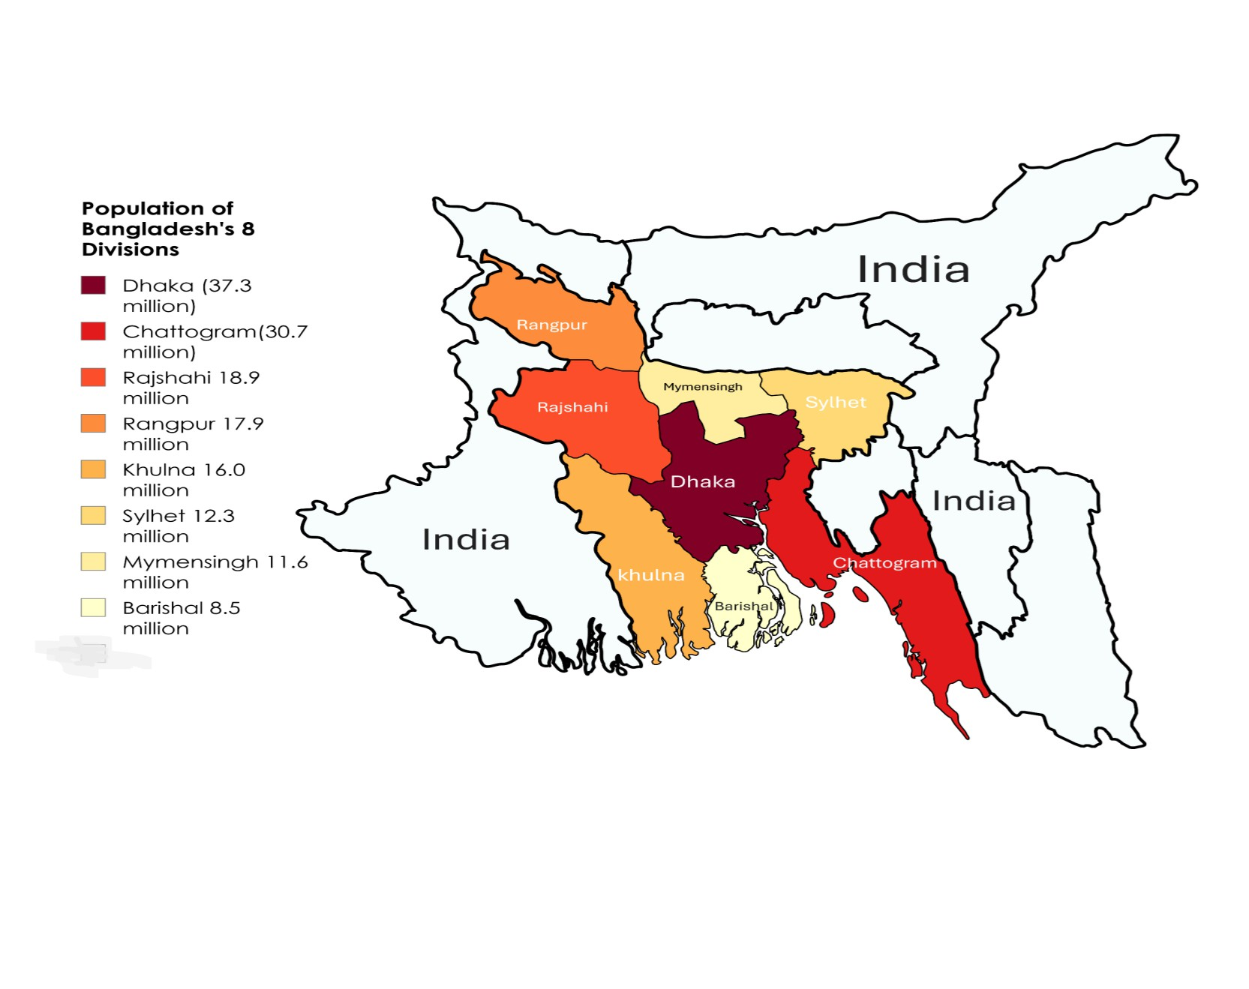
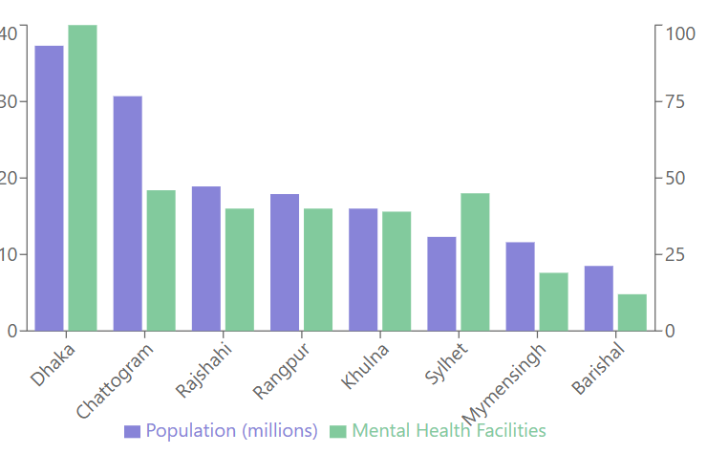
Graphical Analysis
Fig 1 : Population vs. Mental Health Facilities by Division
Fig 2 : Population According Division

Slide 8
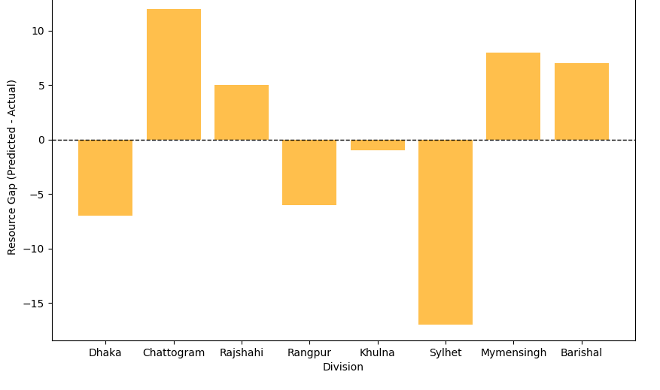
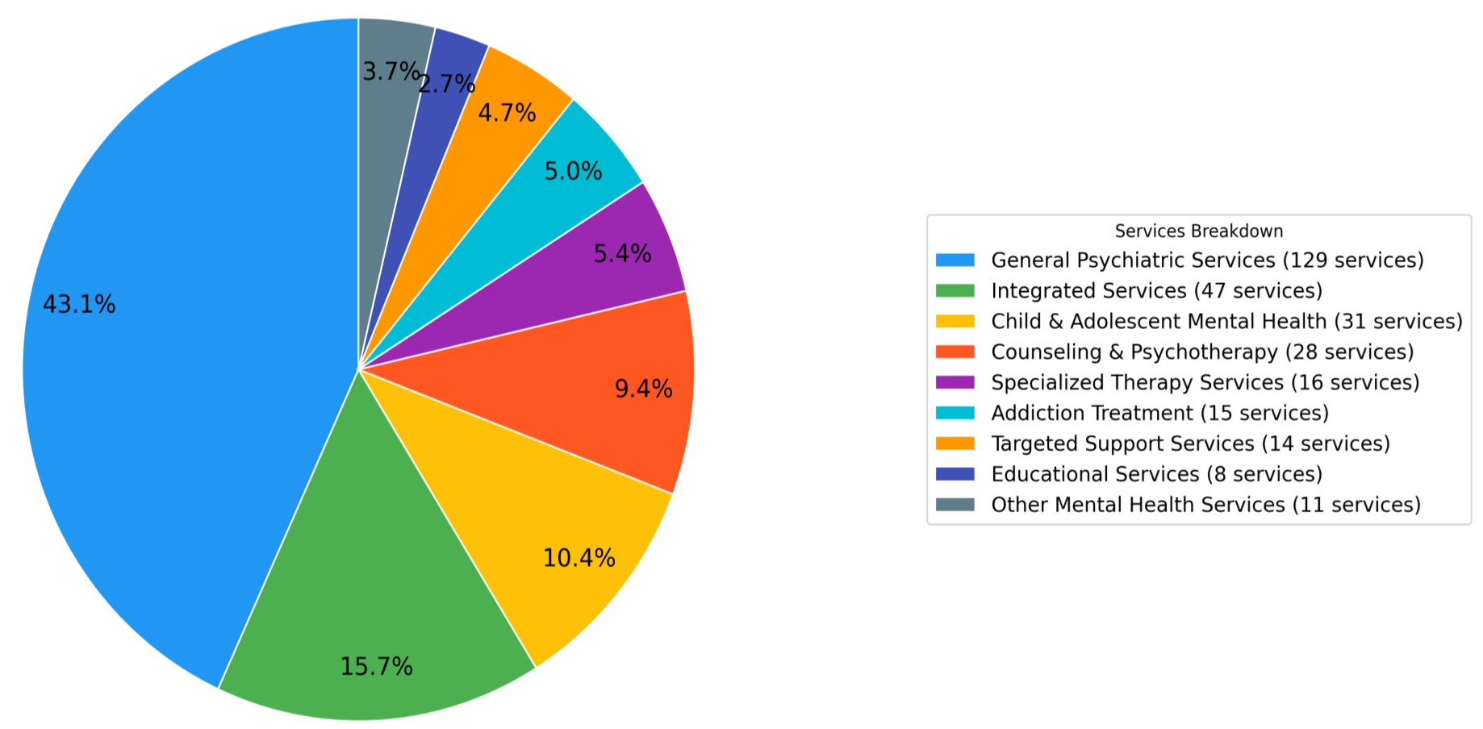
Graphical Analysis
Fig 3 : Gaps Between predicted and Actual Resources
Allocations
Fig 4 : Distribution of Mental Health Services

Slide 9
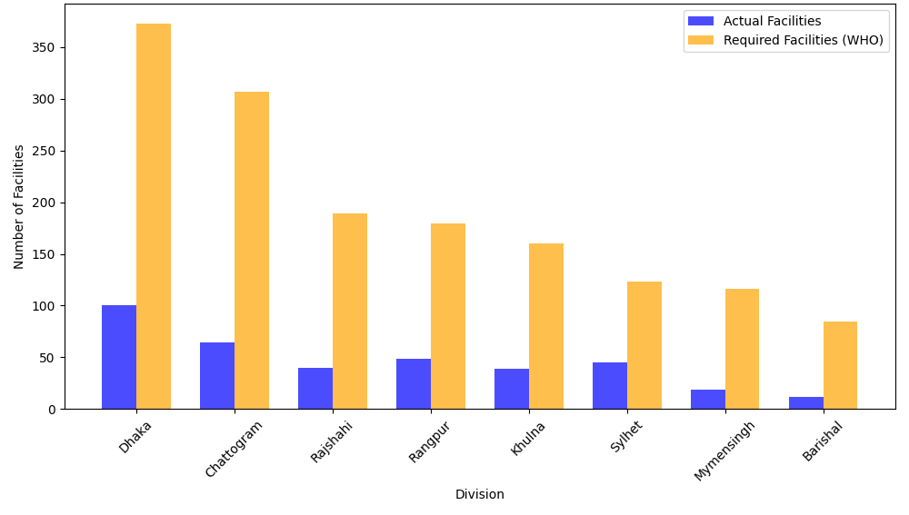
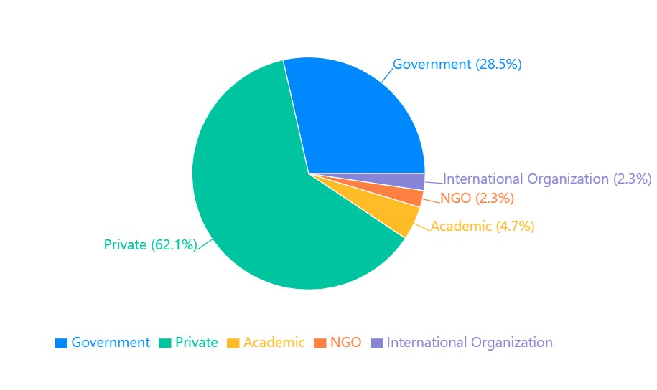
Graphical Analysis
Fig 5 : Comparison of Actual vs. WHO-Recommended Mental Health Facilities per Division
Fig 6: Distribution of Mental Health Facilities in Bangladesh

Slide 10
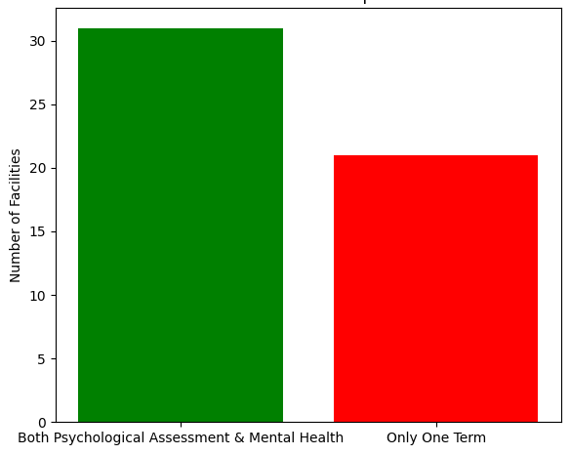
Graphical Analysis
Fig 7 : Service Overlap

Slide 11
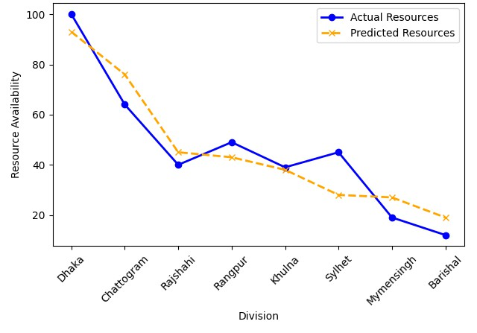
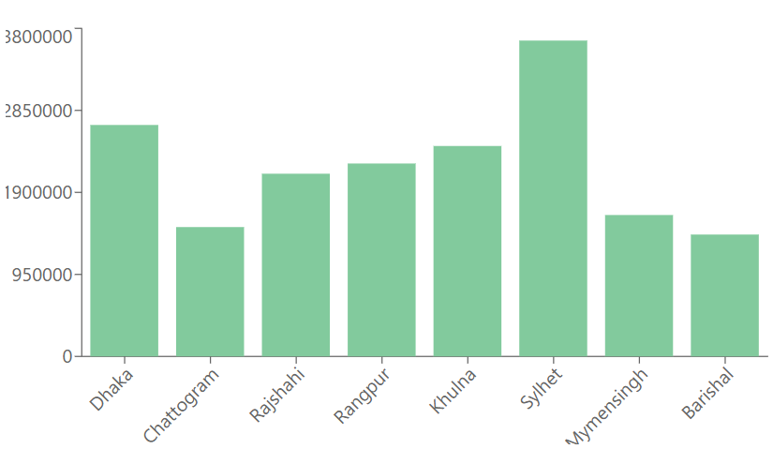
Graphical Analysis
Fig 9 : Predicted vs. Actual Mental Health Resources by Division
Fig 8 : Mental Health Facilities per Million Population

Slide 12
Results and Discussion(Cntd.)
Table 1: Correlation Analysis Between Population and Mental Health Facilities in Bangladesh
VARIABLES | CORRELATION (R) | STRENGTH | DIRECTION
Population vs Total Facilities | 0.9758 | Strong | Positive
Population vs Government Facilities | 0.9756 | Strong | Positive
Population vs Private Facilities | 0.9761 | Strong | Positive
Government vs Private Facilities | 0.9999 | Strong | Positive

Slide 13
Conclusion and Future Work
Mental health infrastructure does not meet national demand.
Evidence supports need for higher investment and policy reform.
Future work: finer‑scale data, primary surveys, and predictive modeling.
Integrate socioeconomic factors and evaluate program effectiveness.

Slide 14
References
[1] World Health Organization, Mental Health Atlas 2025, Geneva, Switzerland: WHO Press, 2025.
[2] Government of Bangladesh, National Mental Health Survey of Bangladesh, Dhaka, Bangladesh: Ministry of Health and Family Welfare, 2025.
[3] World Bank, Mental Health Financing in Low- and Middle-Income Countries, Washington, DC, USA: World Bank Publications, 2024.
[4] World Health Organization, WHO Special Initiative for Mental Health (2019–2023): Universal Health Coverage for Mental Health, Geneva, Switzerland: WHO, 2023.
[5] H. Patel, S. Saxena, and V. Lund, “Addressing the burden of mental disorders in low-income countries,” The Lancet Psychiatry, vol. 8, no. 3, pp. 234–242, 2021.

